Slide 1
The Case for State Testing
A Webinar Hosted By
The National Center for the Improvement of Educational Assessment
April 2, 2025

Slide 2
Today’s Agenda
3:00 Welcome and introductions
3:10 Highlights from The Case for State Testing
3:30 Perspectives from a state chief
3:40 Perspectives from a national policy leader
3:50 Panel (and audience) discussion
4:15 Open Q & A
4:25 Closing
4:30 Adjourn

Slide 3
Who’s Here?
Scott Marion
Executive Director
Center for Assessment
Carey Wright
State Superintendent
Maryland State
Department of Education
Jessica Baghian
President
Watershed Advisors
Juan D’Brot
Senior Associate
Center for Assessment

Slide 4
The Case for State Testing

Slide 5
Highlights From: The Case for State Testing
Scott Marion
The National Center for the Improvement of Educational Assessment
April 2, 2025

Slide 6
Framing
What if nobody was checking your speed?
In our world, would states continue to test if the U.S. Department of Education was disbanded or reduced its enforcement of testing requirements?

Slide 7
Purposes and Uses of State Assessments
The following four purposes and uses make a vital case for state tests:
Monitoring statewide educational growth and achievement
Evaluation and continuous improvement
Transparency and public engagement
Signaling rich learning expectations

Slide 8
Monitoring Achievement and Growth
Provide a means for comparably documenting student growth and achievement
Provide insight into how individuals and groups of students progress over time
Allows state leaders to evaluate the degree to which school districts provide equitable and appropriate learning opportunities for all students

Slide 9
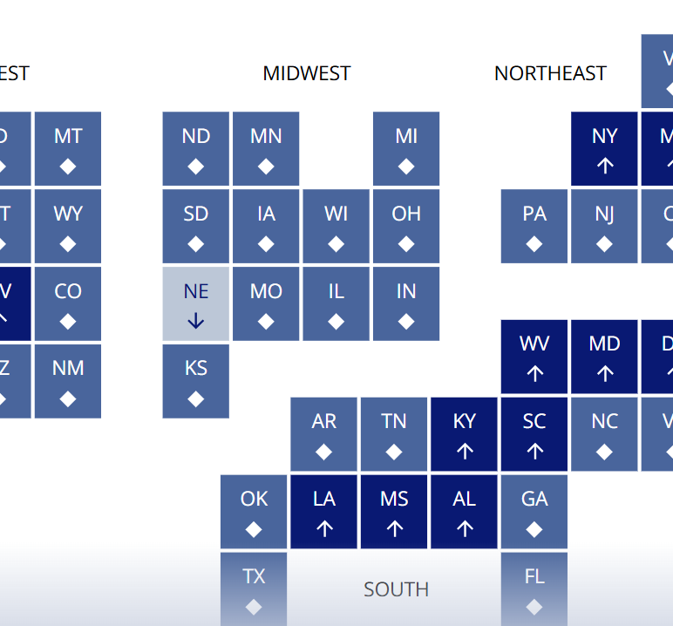
The Nation’s Report Card
Just like state tests are critical for monitoring statewide achievement, NAEP serves a vital function in monitoring nationwide achievement.
Further, NAEP helps improve state assessments in many ways!
We need NAEP!

Slide 10
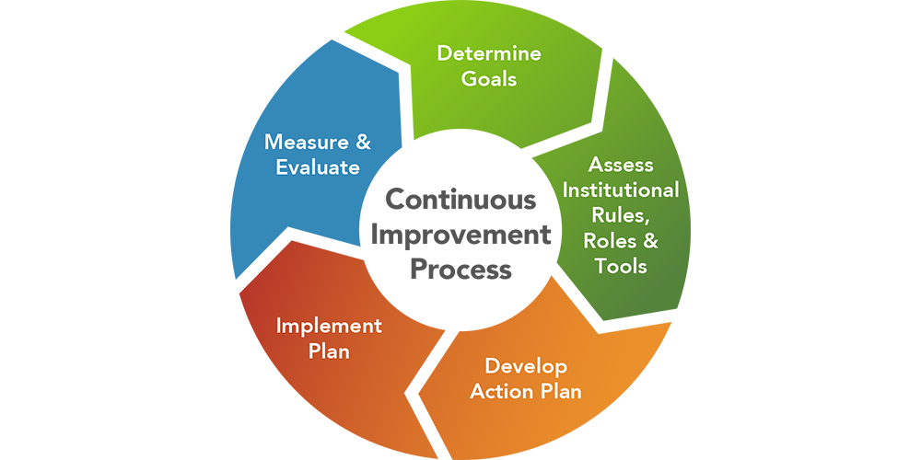
Evaluation and Continuous Improvement
State tests can help leaders and policymakers understand which programs and policies are effective and which are not.
Evaluation and continuous improvement should occur at both local and state levels.
State assessments are an appropriate outcome because of the test’s superior technical quality, especially its alignment with the state’s learning standards.

Slide 11
Transparency and Public Engagement
Comparable statewide test scores can help build public trust in our educational systems.
State assessment scores can engage parents and other members of the public in conversations about their local schools and their students’ futures.

Slide 12
Signaling Rich Learning Expectations
High-quality state tests can meaningfully represent the intended learning goals.
To do so, tests should include extended writing tasks and performance assessments that require students to apply their knowledge and skills to solve complex problems.

Slide 13
We Know They Aren’t Perfect, But…
We are not saying that all state tests serve these four purposes as well as we might like, but we believe that state tests hold the greatest promise of doing this, even if they currently fall short in some areas.
Why?
State summative exams have been held to the highest quality standards of any tests administered to K-12 students in the country.

Slide 14
Technical Quality
State tests must meet the following rigorous quality criteria to serve these important purposes and uses:
Validity
Alignment
Reliability
Fairness and accessibility
Comparability
The level of independent review and evaluation and the resulting transparency is far beyond what we see for any other assessment administered to K-12 students.

Slide 15
Educator Involvement
Statewide achievement tests are unique in their level of educator involvement:
Write test questions
Score open-ended questions
Serve on content and bias/sensitivity review committees
Review field test results
Serve on standard-setting committees

Slide 16
Don’t Fall For Simple Solutions
District leaders regularly pressure state assessment leaders to replace the state test with their favorite commercial interim assessment. The rationale is simple and somewhat compelling: “We already use Assessment X three times each year, and we like the results. Why should we take time with a state assessment too?”
The answer is quite simple. Commercial interim assessments are not designed to support the summative purposes described throughout this document.
They are designed for different use cases than statewide summative assessments.

Slide 17
Take Home Message
State assessments are designed to serve the major purposes we discussed and are the highest-quality assessments administered to our K-12 students.
We can’t give up on them, even if the federal government takes its foot off the pedal.

Slide 18
Carey Wright
3:30

Slide 19
Closing the Honesty Gap
Before Mississippi implemented a high-quality state assessment system aligned to state academic standards there was an "honesty gap" between NAEP proficiency and state assessment proficiency.
State tests given before 2014-15 showed 50-70% proficiency levels, while NAEP proficiency was 20-25%.
State assessments also close the "honesty gap" between student report cards and students' true competencies.

Slide 20
Value of Assessment Data
State assessment data informs professional learning strategies for teachers and identifies which schools need literacy and math coaching support.
Assessment results show lawmakers their return on investment in education and make the case for continued investments.
Assessment data helps attract philanthropic support for initiatives that produce measurable results.

Slide 21
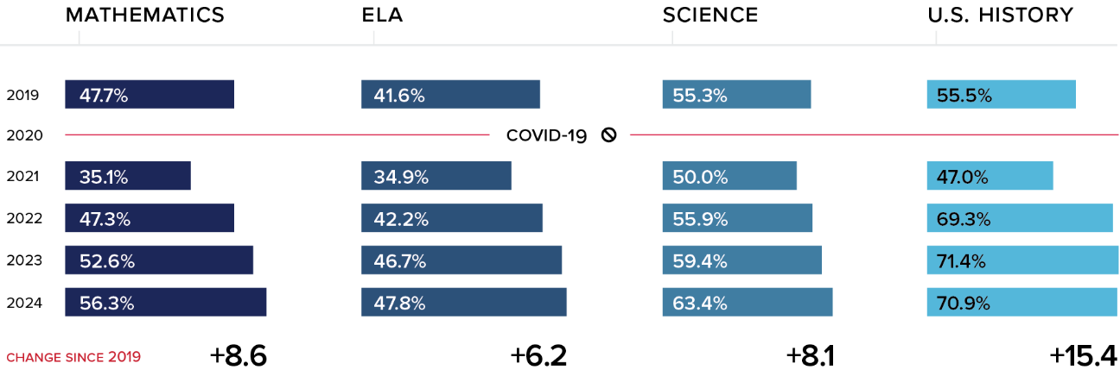
Mississippi Academic Assessment Program Gains 2019-2024
Source: Mississippi Department of Education

Slide 22
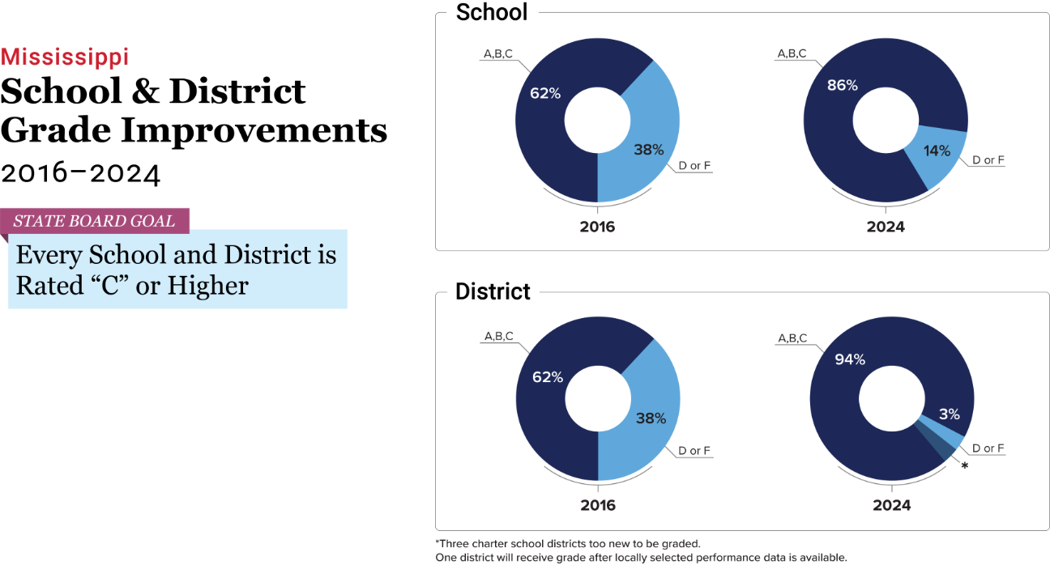
Mississippi Outcomes
Source: Mississippi Department of Education

Slide 23
Mississippi NAEP Rankings

Slide 24
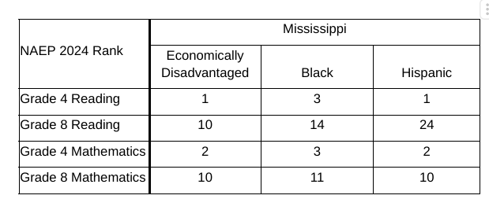
Mississippi NAEP Subgroup Rankings

Slide 25
Maryland Reforms
Urgent action to address decade of decline in student achievement and educators’ lack of confidence in state assessment:
Formed Assessment and Accountability Task Force to make recommendations to improve student achievement.
Reviewed and updated academic standards.
Issued RFP for new statewide assessment aligned to academic standards.
Currently revising accountability model following the work of the Assessment and Accountability Task Force.

Slide 26
Jessica Baghian
3:40

Slide 27
We Can’t Ostrich Our Way to Outcomes
Education is the single biggest line item in most state budgets.
The stakes (both financial and for our future prosperity) are simply too high for state assessments to even be up for debate.
The real question we should ask is: “How can we make these tests better to more fully meet the needs of students, educators, families, and policymakers?”

Slide 28
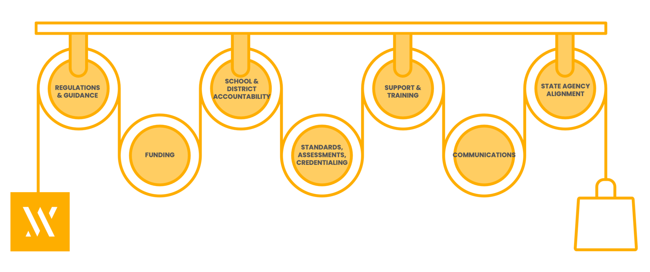
Make the Right Choice the Easy Choice
Assessments are one of a state’s most powerful pulleys to influence educator behaviors in schools and districts, creating immediate and sustained impact on student learning.

Slide 29
Good Assessments Create Coherence
In Louisiana, our academic strategy put standards and curriculum at the center, with aligned assessments and professional development supporting coherent implementation.

Slide 30
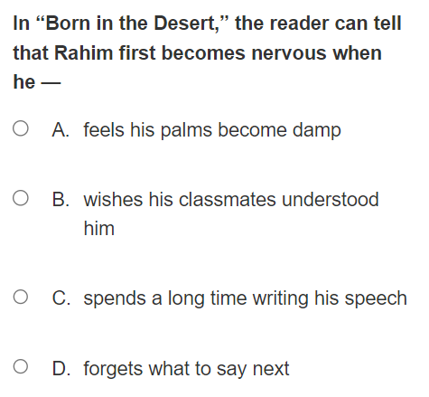
Good Assessments Reinforce Good Instruction
These are two real examples from state 5th grade ELA assessments – one, a multiple-choice question, and the other, an essay.

Slide 31
Panel Discussion

Slide 32
General Q & A

Slide 33
Closing

Slide 34
The Case for State Accountability
Following The Case for State Testing, we just published The Case for Statewide School Accountability
Stay tuned for an upcoming webinar…

Slide 35
Please continue your important work!
Reach out with any questions.

